Slide 1

US Refractory Products
Veera Aprajita, Rishabh Banola,
Rich Fong, Morris Lee, Barry McCoy
Notes:
Morris

Slide 2
Problem
The current state of the data collection process does not enable any insightful analysis to the production schedule, labor, and throughput of the business (garbage in, garbage out).
Standardization and consistency of data is critical to drive towards a more data-driven organization allowing decisions to be made based on empirical data instead of gut intuition.
Notes:
Morris

Slide 3
Recommendations
Enforcing the new data collection process is critical to driving towards a more data-driven organization.
Collecting and analyzing data enables USRP to:
Identify patterns and trends to make better informed decisions in the future
Improve production processes by optimizing existing processes, reduce costs, and increase efficiency
Forecast market demand for its products and adjust production, labor hours, purchases, and more
Process and value will exponentially increase over time as more data is collected.
Notes:
Morris

Slide 4
Define
CTQ’s (Critical To Quality)
Capable data collection of processes
Blending, Canning, Casting, Hook-up, Ovens, Packing, and Strippings
Standardization of data
Consistent with forms and database
Measurement of labor hours and productivity
Hours, OT, parts created
Robust and scalable dashboard and database
Easily repeatable process to ensure standard collection long-term
Notes:
Rich

Slide 5
Measure
Data from the shop floor will be collected based on the new data model and updated paper forms resulting in stronger decision making and insight into performance data of each department.
Inputs:
Labor Hours - measure time spent on each process in each department
Outputs:
Weight, lances, pieces, and shapes - measure production of items for each process/shift
Scrap - measure amount of scrap produced by each process
With this data we can measure productivity/efficiency and waste produced for each department and individual
Notes:
Rich

Slide 6
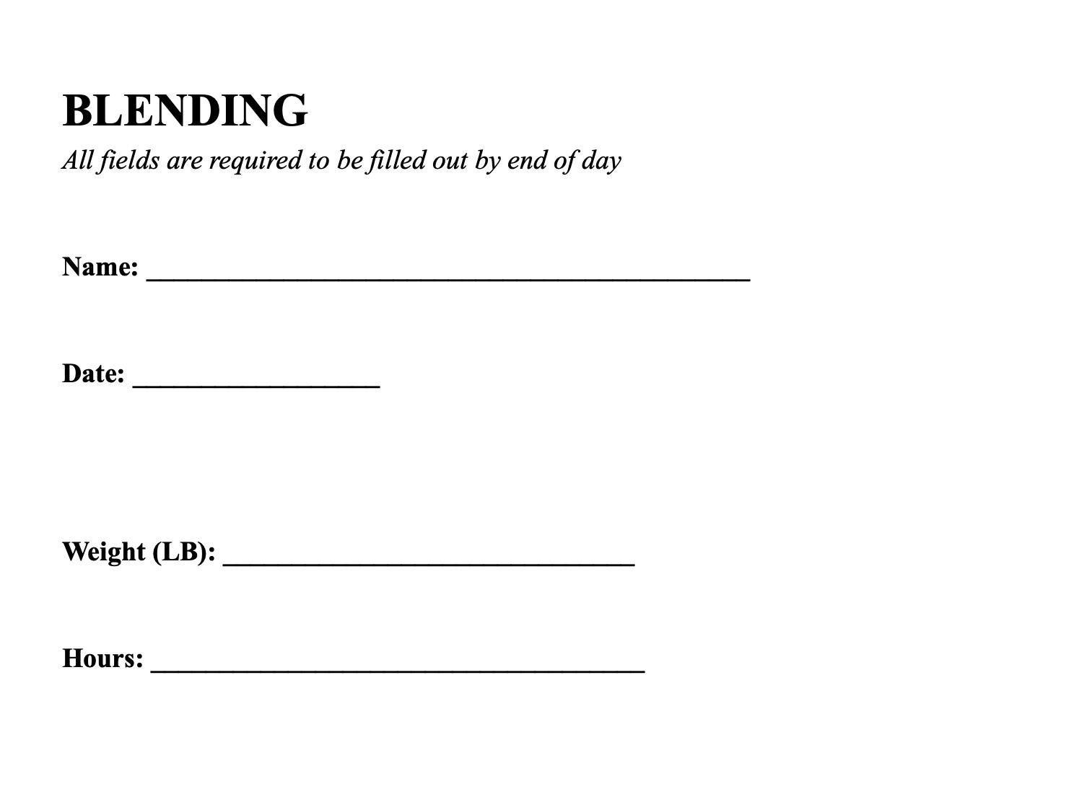
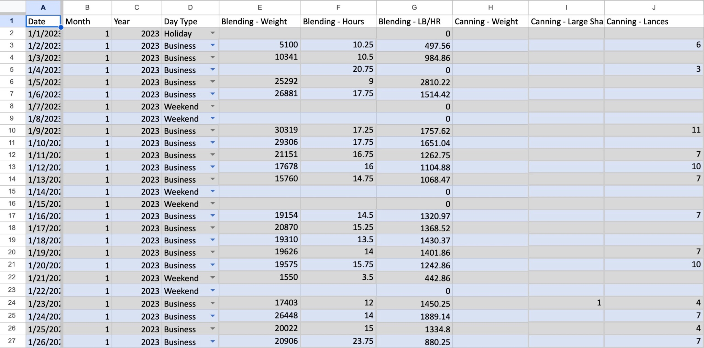
Paper Forms
Notes:
Rich

Slide 7
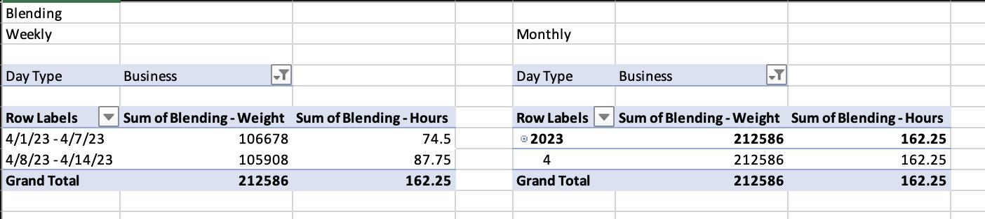
Analyze
More Data = More Insight
Setting benchmarks for productivity
Comparing weekly scrap with parts made by department
Comparing estimates to actual productivity
Notes:
Morris

Slide 8
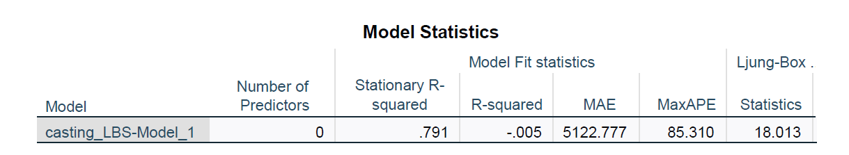
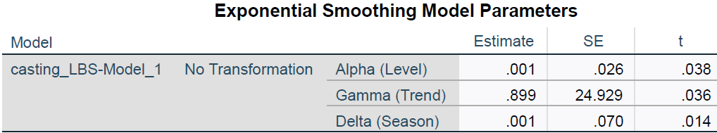
Analysis (2 Weeks Data)
We performed an SPSS forecasting on the provided two weeks data using Exponential Smoothing - Winter Additive Method (For Casting process)
It is used to predict future values of a time series. This method is a combination of three components: level, trend, and seasonality, and is useful when the data exhibit a pattern over a time period.
Notes:
Rishabh

Slide 9
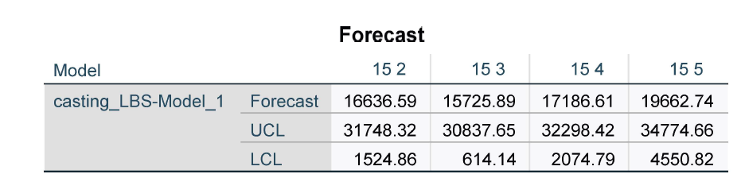
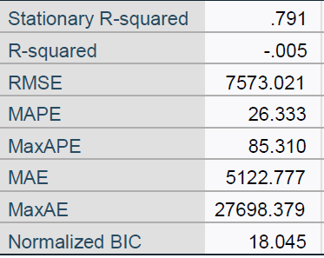
Forecast
With a 95% confidence level, we can say that forecasted numbers for Daily casting in week 15 will be between:
Estimate ± (2xRMSE).
Notes:
Rishabh

Slide 10
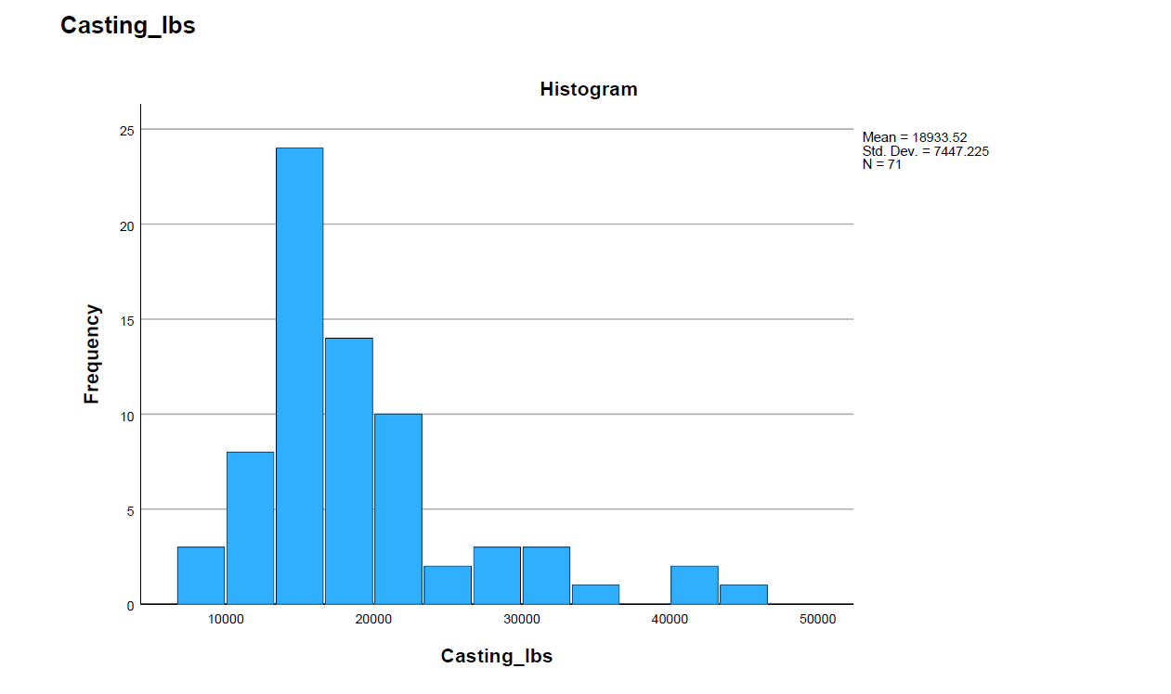
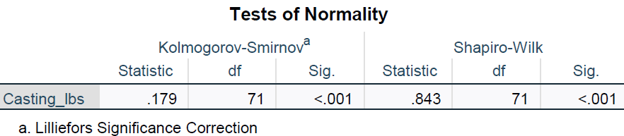
Normality Test
Using Shapiro-Wilks Test, we found that its significance was 0.01 (<0.05) which is unacceptable. This combined with the histogram shows that the assumption of normality was invalid using this model.
Estimate ± (2xRMSE).
Notes:
Rishabh

Slide 11
Inference from Tests
Data set is too small for forecasting analysis, instead use as benchmark.
High RMSE
Poor R-Square
Fails normal assumption
Data size of two weeks is very small, and the accuracy of the forecasts are limited by the small amount of historical data and does not capture the full range of variation causing low R-squared values and poor model fit.
Additionally, small datasets can also be more prone to random fluctuations and outliers, which can affect the normality assumptions of the model.
Notes:
Rishabh

Slide 12
Improve
Creating a data-driven culture and educating staff will will result in better decision making for the business as well as transparency into the actual performance factors of each department.
Implement updated forms and data file for collection and processing
Use updated dashboard to begin tracking weekly and monthly data
Consistent data for more robust analysis
Review data frequently
Notes:
Barry

Slide 13
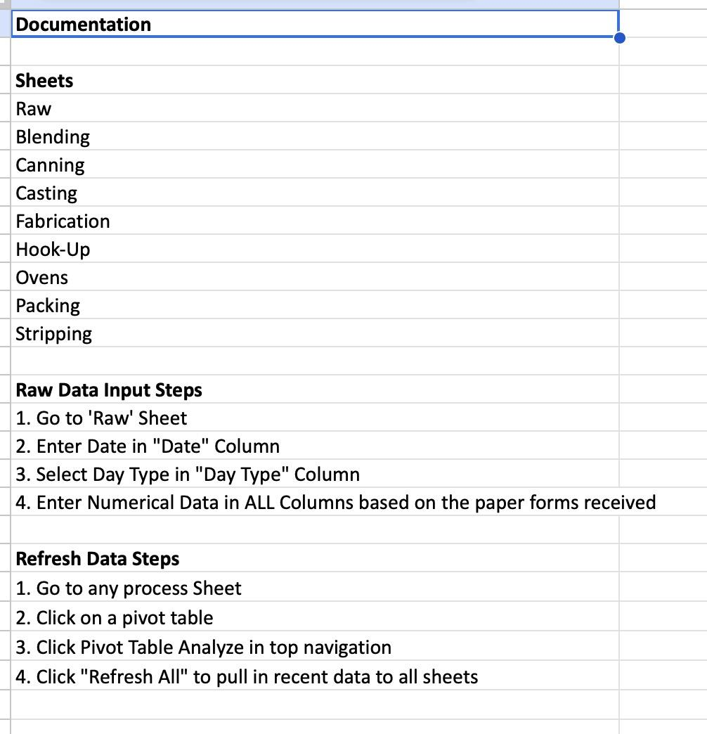
Control
Robust model along with accountable reporting can ensure the process continues to improve the business and upgrade over time.
Documentation included in file.
Ensure proper education of new data file for long-term utilization
Maintaining the model with monthly data refreshes
Notes:
Veera

Slide 14
Next Steps
Continue enforcing and implementing the new data collection.
Educate staff on the importance of data
Provide incentives or benefits to increase adoption of new data methods
Implement data collection method across all processes
Expand collection metrics
Review data frequently
Expand dashboard for deeper analysis
Notes:
Barry

Slide 15
Questions?

